Slide 1

The Newman Catholic Trust &
St Bonaventure’s
www.newmancatholictrust.com

Slide 2
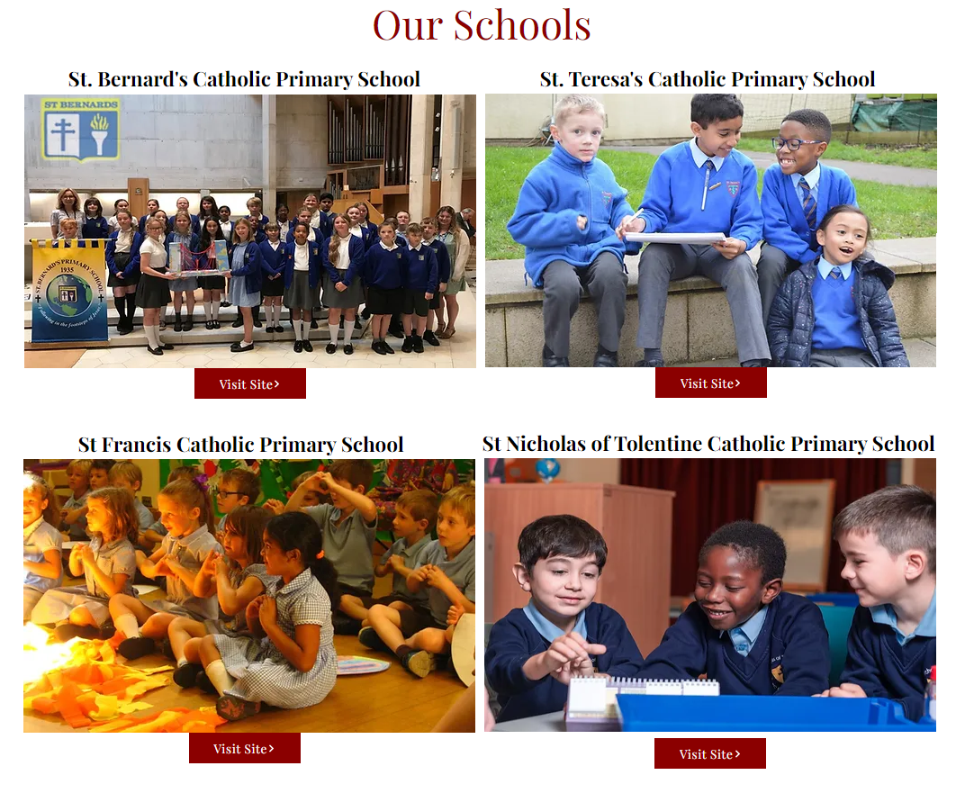




Who are the Trust:
08

Slide 3
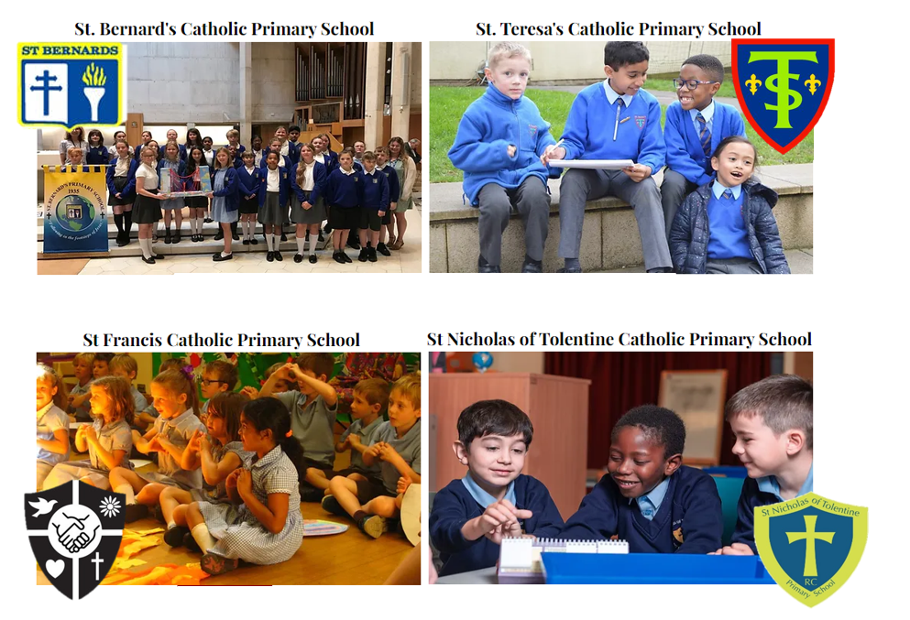


Who are the Trust:
08

Slide 4
Vision:
To be a leading provider of outstanding, sustainable Catholic education
08
Mission:
1. Provide outstanding and sustainable catholic education from nursery to sixth form
2. Provide high quality teaching and learning & enrichment opportunities to our students
3. Be an employer of choice with excellent training & development opportunities for staff
4. Be a Trust of choice for families in our local communities
5. Grow by supporting catholic schools to join our Trust
Values:
Christ & child-centred
Inclusive & consultative
Caring
Transparent
Strategic
Professional
Accountable

Slide 5

Our Trust Strategy
Harness our collective expertise to drive school improvement and realise the best for all children and adults
Celebrate and communicate the successes in our schools to encourage aspiration and innovation.
Provide support and challenge for each school so that every child meets their full potential.
Recognise and celebrate each school’s uniqueness - valuing all members of our Trust family.
Work collectively to tackle the challenges facing schools

Slide 6
Our strategy - how do we do this?
Committed to each school’s ethos and uniqueness
Have a clear Trust strategy for addressing key issues (behaviour, SEND, finances, school improvement)
Strong school improvement support (using external experts and Trust specialists)
Shared services (SEND, training/CPD, qualifications, interventions)
Employer of choice, train and retain quality staff
Support for leaders: Ofsted/CSI, HR; legal, GDPR, recruitment, policy development, Governor training

Slide 7

Why a Trust?

Slide 8
What are the benefits for the children?
Strong curriculum led by highly trained teachers and subject leaders/champions
Driving standards, outcomes, life chances; serving the community
Pupil-led peer reviews; Trust learning/sharing days
Sharing strong practice
Schools working towards shared goals
Shared resources
Leaders freed up to focus on teaching and learning
Structured opportunities (workshops, interventions, support)

Slide 9
What are the benefits for the staff?
Cluster groups, local partnerships, peer-to-peer
Strong professional development at all levels (NPQs)
Clear career progression pathway
Talent spotting and succession planning
Central team support and services
Access to wider expertise, resources, practice
Commitment to being an employer of choice
Beneficial terms and conditions and commitment to wellbeing; being part of the Trust family

Slide 10
What are the benefits for schools?
A chance to share best practice & develop teachers/leaders/support staff
Moderation across Trust; non-judgemental partners; peer-to-peer reviews
Leader support (subjects, self-evaluation, school improvement, Ofsted prep)
Effective and consistent assessment/gap analysis
Access to wider expertise, resources, practice
New educational initiatives and research
Being part of a strong local partnership
Economies of scale increase resources for schools
Collective funding leading to increased efficiencies
Central Team support adding to current school capacity
Tackling issues together
More professional pathways and opportunities

Slide 11
Why now?
Early chance to shape policy, Trust practice and ways of working.
Take shared ownership of the Trust strategy and responsibility for completing the Bishop’s vision.
Greater shape the MAT landscape and how the strategy is “executed”.
Contribute to and help shape the ethos of the MAT and how it conducts its business.
Greater involve itself in the early development and establishment of the MAT, therefore taking greater advantage of opportunities.
Chance to forge strong early relationships with founder members, the Central Team and Board of Directors.
Share expertise, and draw from existing capacity, to help improve own setting and provision for children.

Slide 12

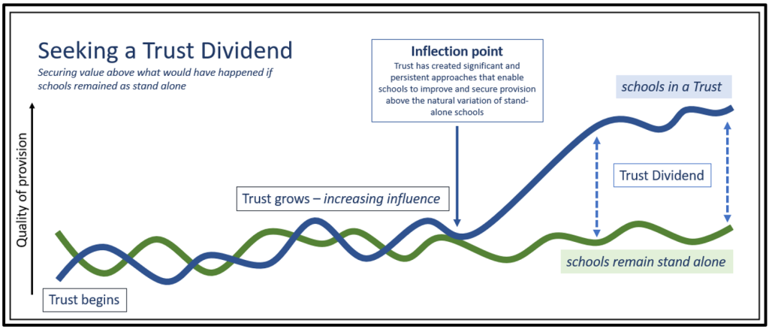

Slide 13
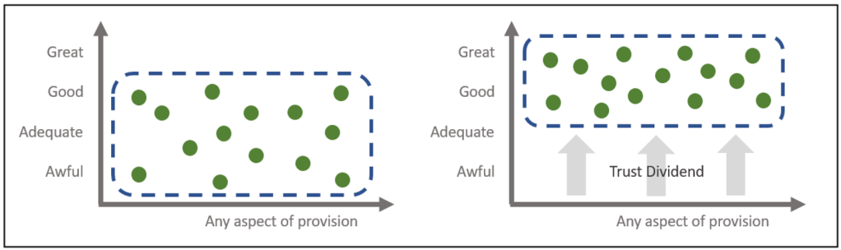

Slide 14
Myth-busting – Multi Academy Trusts
Only failing schools become academies
A school’s uniqueness/identity is lost
Staff lose/change their terms and conditions
Staff are made to work in other schools
All schools have to do the same thing
MATs are businesses that make profit
Central teams are paid enormous salaries
and don’t follow pay-scales
The HT stops being in charge of the budget
The governors lose all their power
There is less transparency in MATs

Slide 15

Myth-busting – Multi Academy Trusts
Only failing schools become academies
A school’s uniqueness/identity is lost
Staff lose/change their terms and conditions
Staff are made to work in other schools
All schools have to do the same thing
MATs are businesses that make profit
Central teams are paid enormous salaries
and don’t follow pay-scales
The HT stops being in charge of the budget
The governors lose all their power
There is less transparency in MATs

Slide 16
Questions?
Notes:
Anne
For the Board and Central Team - this is a key part of the meeting – listening to your thoughts and feedback about what you have heard so far. We will capture all that you raise and if we can’t provide a response this evening we will send out a written response after the meeting.
There are three key questions we would like you to address;
Do you have any concerns about what you have heard this evening?
Are there things you feel we should be aware of in our planning
What haven’t we thought of?

Slide 17

Registered office:
St Nicholas of Tolentine Catholic Primary School
Pennywell Road
BS5 0TJ
www.newmancatholictrust.com

Slide 18
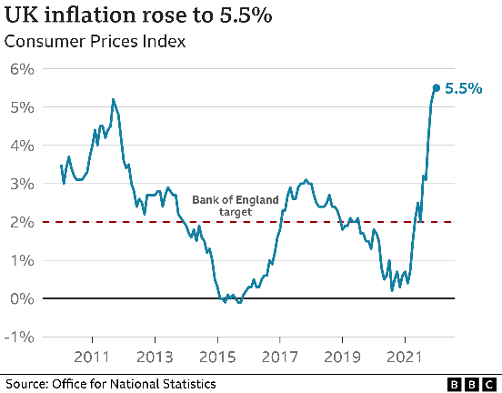
No real-term funding increases from government
Increased competition for school places
Increased needs within the community but less support from government of LA
Increased
Expenditure:
salaries,
utilities,
services/supplies
essentials/food
Local Authorities in significant difficulty, deficits and decline
Ofsted
- All schools inspected by 2025

Slide 19
Coordinating our own services, training and professional development:
- play-based therapy,
- behaviour support,
- shared SEND services,
- EYFS support and school improvement.
Greater savings purchasing together
Trust-based services and contracts for
Utilities,
Cleaning,
IT,
Catering,
HR,
Photocopying,
Even down to paper.
Centralis services and support:
School improvement support
(using external experts)
(providing a peer support Principal)
(developing internal Trust leaders)

Slide 20





Vision for the future
Diocese/Board of Members
Governance Support
Trustees/Board of Directors
Newman Senior Leadership Team
CEO & Accounting Officer
Strong and robust school improvement supported by External advisors/leadership support
CFO
Executive Principal Structure
Principals’ Committee
Operations & Estates Manager
MAT Network Leaders
Maths, R.E, EYFS & PE
MAT coordinated support for SENCO, Safeguarding and Attendance
Office Managers
ICT – centralised
HR – centralised
H&S – centralised
Estates - centralised
LGC
+ link director
LGC
+ link director
LGC
+ link director
LGC
+ link director
Senior Finance Assistants
Finance Assistants
Phase 1: Current 4 schools & secure foundations for expansion

